Slide 1

Interpretable ML for Tuberculosis Detection and Classification from Chest X-ray Image
By: Rahel Sileshi Abdisa
A Ph.D. Synopsis Presentation
Submitted to the Department of Computer Science and Engineering
School of Electrical Engineering and Computing
November/2023
Adama, Ethiopia

Slide 2
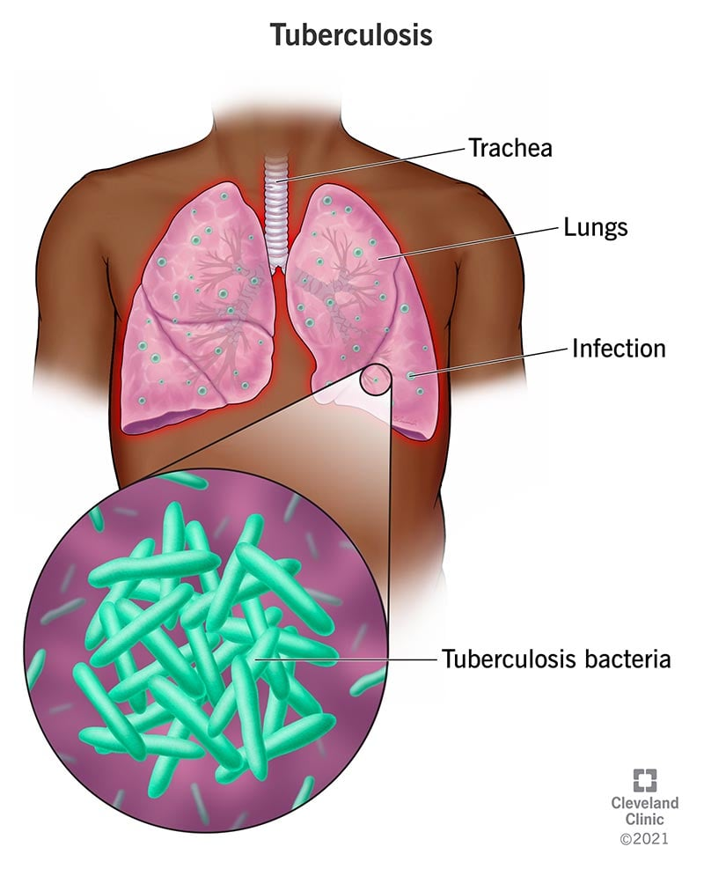
Introduction
Tuberculosis
It is an infectious disease that most often causes infection in the lungs
It is the second most common cause of infectious disease death in millions of individuals each year (Acharya, et al. 2022)
Mycobacterium infected the lungs

Slide 3
Screening
Symptom screening
Is not effective for early detection
Useful for patients at high risk (Jerene et al.2022)
Chest x-ray
High sensitivity to pulmonary TB detection
Suitable for the identification of different diseases from TB
Early detection is possible

Slide 4
Problem statement
Globally, is the second most common cause of infectious disease death on millions of individuals each year (Eshetie et al. 2017)
Ethiopia remains with high TB burden countries, of 119 cases per 100,000 population in 2021 (ministry of health)
In a developing country the incidence and death rate is higher due to
Insufficient laboratory capacity and medical supply
Late diagnosis
Lack of experts

Slide 5
Problem statement
Current diagnosis techniques have limitation
Not applicable for early detection
Prone to error due to subjective decision
Time taking and laborious
Hence, there is a need for automatic, time saver, and accurate diagnostic tools
Computer-aided detection tool
In the TB detection CAD, it has been applied with chest X-ray (CXR) for automatic detection and simplicity.
However, the interpretability of the result has always been a question for clinicians

Slide 6
Problem statement
Using the explainable AI (XAI) limitations in TB diagnosis have been overcome.
Though the findings of the researchers are good, there are still gaps to be filled.

Slide 7
Problem statement
More research has still to be done to engage XAI in the tool and engage detection of TB at an early stage from different diseases, classifying pulmonary TB into the subclasses( active and latent).
Moreover, studies have to engage local data from low-resource settings
A computationally efficient model has to be developed and connected with the appropriate XAI model
Different machine learning/deep learning techniques need to be tested with different algorithms of XAI.

Slide 8
Research questions
How to develop an interpretable model that detects Pulmonary TB from CXR images?
How to develop a computationally efficient model that classifies Pulmonary TB into sub-classes?
How to develop a model that explains the result of TB CXR images and clinically apply?

Slide 9
Objectives
General Objectives
Development of Interpretable ML for Tuberculosis Detection and Classification from Chest X-ray Image
Specific objectives
To develop an interpretable model that detects Pulmonary TB from CXR images
To develop a computationally efficient model that classifies Pulmonary TB into sub-classes
To classify a model that explains the result of TB CXR images clinically
Including various types TB in the study

Slide 10
Related works and gaps
Author | Methodology | Contribution | Parameters | Limitations
Muhammad Ayaz et al.[16] | CNN architecture and applied ensemble learning | 99% and 97% of ROC curves The essemble achieved better than other classifiers | Train time =62.74 min Test time =22.37 s | Did not apply the interpretable and explainable ML to their work
Chirath Dasanayaka 2020 [17] | DCNN and transfer learning genetic algorithm based hyper parameter tuning, and model ensembling | accuracy of 97.1% Youden’s index-0.941, sensitivity of 97.9%, specificity of 96.2%) | training parameters 49,66,118 | Did not apply the interpretable and explainable ML to their work

Slide 11
Related works and gaps
Sandeep et al.[1], | ImageNet fine-tuned Normalization-Free CNN Network Model Collaborated XAI with the model | 96.91% accuracy, 99.38% AUC, 91.81% Sensitivity 98.42% specificity | 9,696,071 | Did not apply the characterization of other pulmonary diseases apart from pulmonary TB from suspected CXR image A lot of trainable parameters
Ovi Sarkar et al. [20] | Different XAI algorithms Multi-Scale Convolutional Neural Network (MS-CNN) | Detected different diseases from CXR image and identified TB Algorithms of XAI have contributed interpretability | Train=76.74 min Test=45.37 s | The paper did not cover the sub classification of TB in this work.

Slide 12
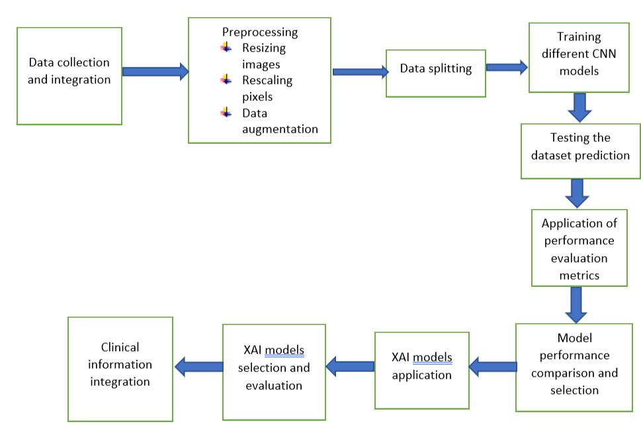
General flow the work

Slide 13
Proposed methods
Data: CXR data will be collected from EAII and prepared
Preprocessing:
Image resizing
Image rescaling
dimensionality reduction
data augmentation
Will be applied accordingly.

Slide 14
Proposed methods
Analysis:
CNN model development
Train and test the model
XAI development
Implementing the developed models tested with the data clinically

Slide 15
Material Requirement
Soft wares:
Personal computers
Hardware:
Chest X-ray

Slide 16
Expected output
Computationally efficient
Interpretable deep learning model
Classification of different subtypes of TB

Slide 17
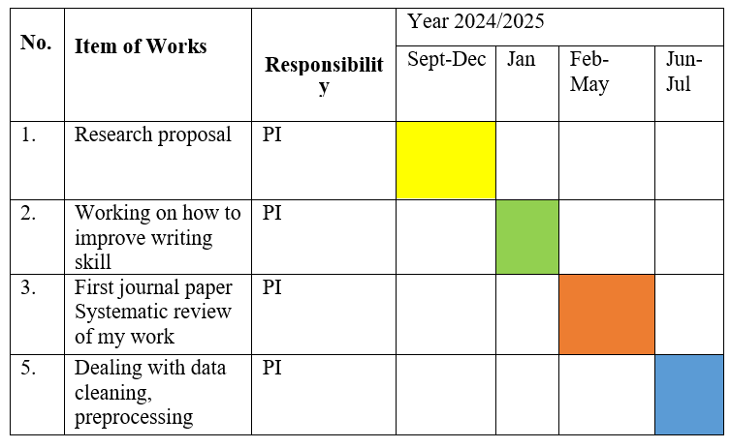
Timeline

Slide 18
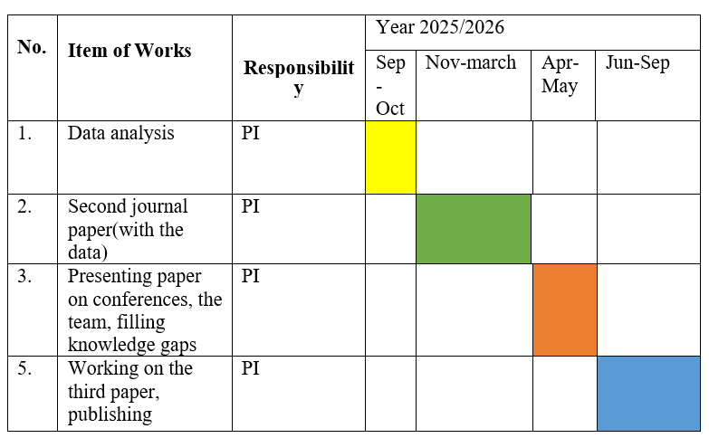
Timeline

Slide 19
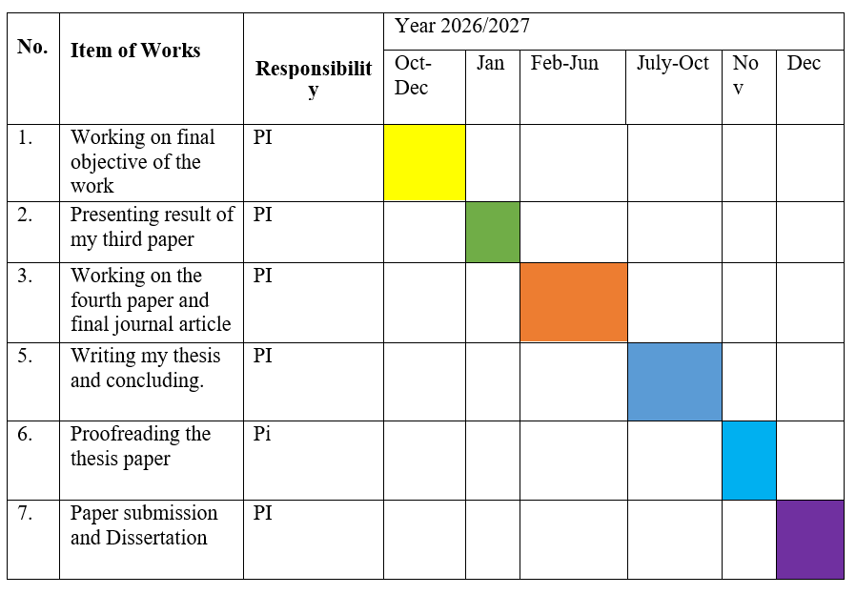
Timeline

Slide 20
Budget breakdown
S/No | Category | Description of activities/tasks | Unit | Rate/unit | Qty | Function | Total Price
1 | Personal (Peridium) | 15-days peridium for radiologist assistance on data | Person | 724 birr/ day | 1 | 1*40*724 | 10,860
 |  | 20-days Peridium for chest x-ray technician | Person | 724/day | 1 | 1*30*724 | 14,480
2 | Stationary | Printing, binding | Materials | - | - | - | 10,660
3 | Internet | 4 years Internet data | Data | 6000/year | 4 | 4*6000 | 24,000
Total |  |  |  |  |  |  | 60,000

Slide 21
Reference
[1] V. Acharya et al., “AI-Assisted Tuberculosis Detection and Classification from Chest X-Rays Using a Deep Learning Normalization-Free Network Model,” vol. 2022, 2022.
[2] “Tuberculosis_ Causes, Symptoms, Diagnosis & Treatment.”
[3] S. Eshetie et al., “Multidrug resistant tuberculosis in Ethiopian settings and its association with previous history of anti-tuberculosis treatment: A systematic review and meta-analysis,” BMC Infect. Dis., vol. 17, no. 1, 2017, doi: 10.1186/s12879-017-2323-y.
[4] S. Bagchi, “WHO’s Global Tuberculosis Report 2022,” The Lancet Microbe, vol. 4, no. 1, p. e20, 2023, doi: 10.1016/s2666-5247(22)00359-7.
[5] C. Dye, S. Scheele, P. Dolin, V. Pathania, and M. C. Raviglione, “Global burden of tuberculosis: Estimated incidence, prevalence, and mortality by country: WHO Global Surveillance and Monitoring Project. JAMA. 1999 Aug 18;282(7):677–86.,” J. Am. Med. Assoc., vol. 282, no. 7, pp. 677–686, 1999.

Slide 22
Thank you!!!

